Slide 1
Lecture 2 - Names & Functions
09/25
Slides adapted from Berkeley CS61a

Slide 2
Program Structure

Slide 3
Review - Expressions
Primitive Expressions:
2
“hello!”
add
numbers
strings
names
Arithmetic Expressions:
1 + 2
15 // 3
add(3, 4)
Call Expressions:
max(add(2, 3), 5 * min(-1, 4))

Slide 4
Review - Evaluating Call Expressions
add ( 2 , 3 )
Operator
Operand
Operand
Evaluate
Evaluate the operator subexpression
Evaluate each operand subexpression
Apply
Apply the value of the operator subexpression to the values of the operand subexpression

Slide 5
Nested Call Expression
Evaluate operator Evaluate operands Apply!
1
2
3
45
add(add(6, mul(4, 6)), mul(3, 5))
add
30
15
add(6, mul(4, 6))
mul(3, 5)
24
add
6
mul(4, 6)
mul
3
5
mul
4
6
Expression Tree

Slide 6
Values
Programs manipulate values
Values represent different types of data
Integers:
2
44
-3
Strings:
“hello!”
“cs61a”
Floats:
3.14
4.5
-2.0
Booleans:
True
False

Slide 7
Expressions & Values
Expressions evaluate to values in one or more steps
Expression:
Value:
‘hello!’
‘hello!’
7 / 2
3.5
add(1, max(2, 3))
4

Slide 8
Names
Demo
Values can be assigned to names to make referring to them easier.
A name can only be bound to a single value.
7
x
One way to introduce a new name in a program is with an assignment statement.
x = 1 + 2 * 3 - 4 // 5
Name
Expression
Statements affect the program, but do not evaluate to values.

Slide 9
Check Your Understanding
>>> f = min
>>> f = max
>>> g, h = min, max
>>> max = g
>>> max(f(2, g(h(1, 5), 3)), 4)
???

Slide 10
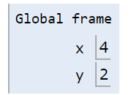
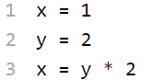
Visualizing Assignment
Demo
Names are bound to values in an environment
To execute an assignment statement:
Evaluate the expression to the right of =.
Bind the value of the expression to the name to the left of = in the current environment.
Final Value
Name
Bindings
Notes:
http://pythontutor.com/visualize.html#code=x%20%3D%201%0Ay%20%3D%20x%0Ax%20%3D%202%0Ax,%20y%20%3D%20x%20%2B%20y,%20x&cumulative=true&curInstr=0&heapPrimitives=nevernest&mode=display&origin=opt-frontend.js&py=3&rawInputLstJSON=%5B%5D&textReferences=false

Slide 11
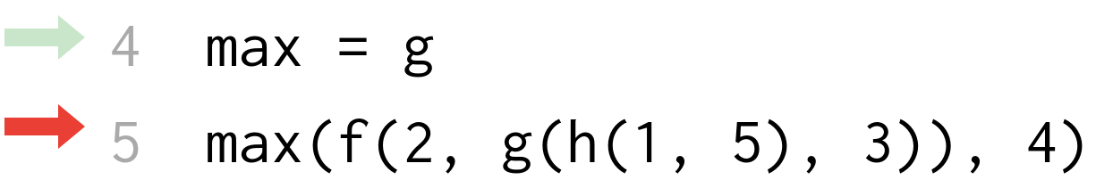
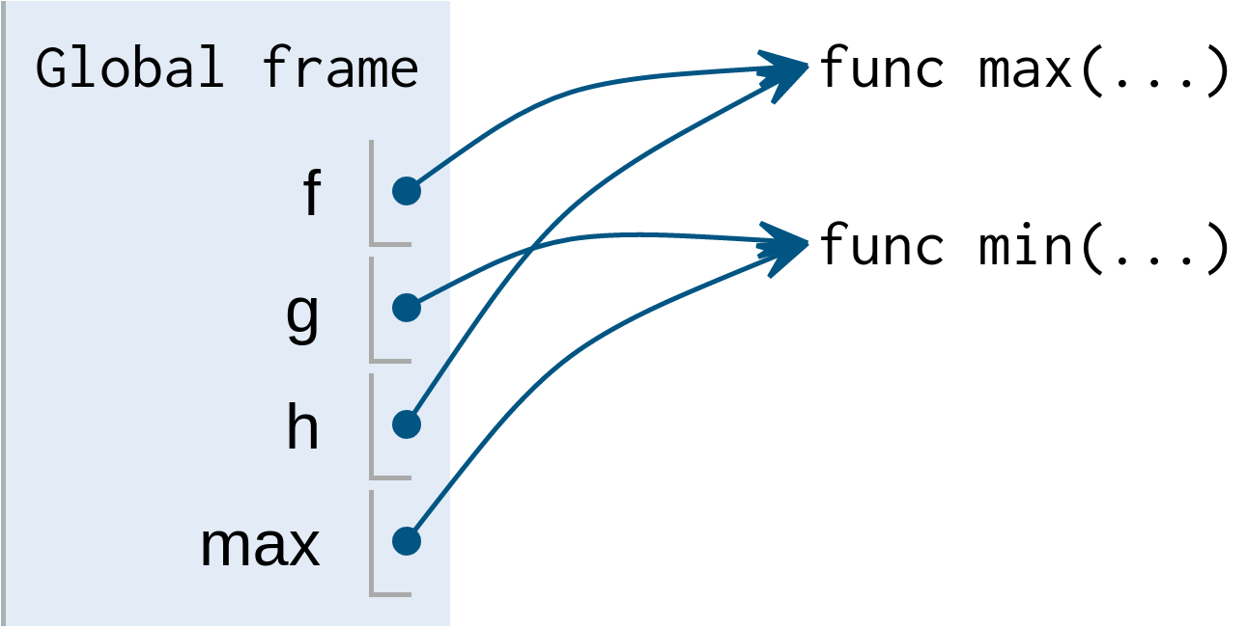
Demo
3
func min(...)
3
4
f(2, g(h(1, 5), 3))
func max(...)
2
3
g(h(1, 5), 3)
3
func min(...)
5
3
h(1, 5)
func max(...)
1
5
Notes:
http://pythontutor.com/visualize.html#code=f%20%3D%20min%0Af%20%3D%20max%0Ag,%20h%20%3D%20min,%20max%0Amax%20%3D%20g%0A&cumulative=true&curInstr=0&heapPrimitives=nevernest&mode=display&origin=opt-frontend.js&py=3&rawInputLstJSON=%5B%5D&textReferences=false

Slide 12
Functions

Slide 13
Functions
Functions allow us to abstract away entire expressions and sequences of computation
They take in some input (known as their arguments) and transform it into an output (the return value)
We can create functions using def statements. Their input is given in a function call, and their output is given by a return statement.
5
square
25

Slide 14
Defining Functions
Demo
Function signature indicates name and number of arguments
def <name>(<parameters>): return <return expression>
def square(x): return x * x y = square(-2)
Function body defines the computation
performed when the function is applied
Execution rule for def Statements
Create a function with signature <name>(<parameters>)
Set the body of that function to be everything indented after the first line
Bind <name> to that function in the current frame

Slide 15
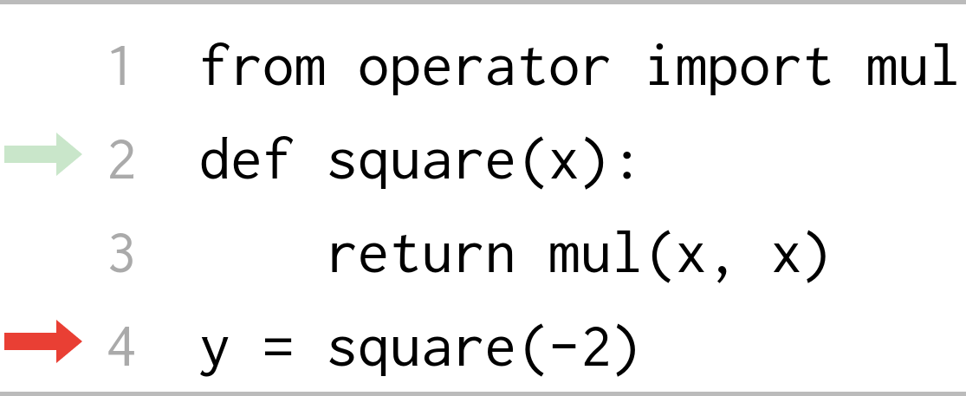
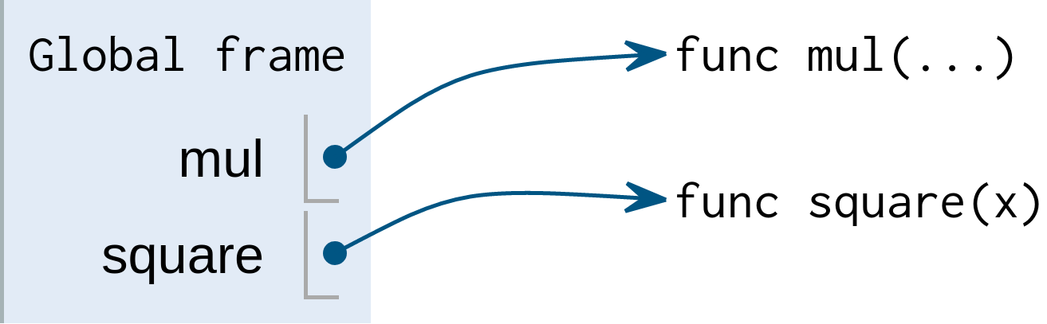
Functions in Environment Diagrams
Built-in function
User-defined function
def statements are a type of assignment that bind names to function values

Slide 16
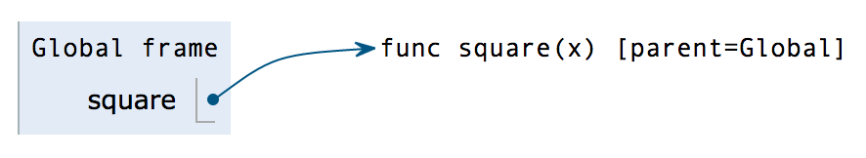
Calling User-Defined Functions
Procedure for calling/applying user-defined functions (for now)
Create a new environment frame
Bind the function's parameters to its arguments in that frame
Execute the body of the function in the new environment
def square(x):
return x * x
square(-2)

Slide 17
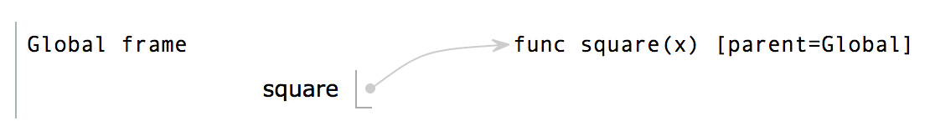
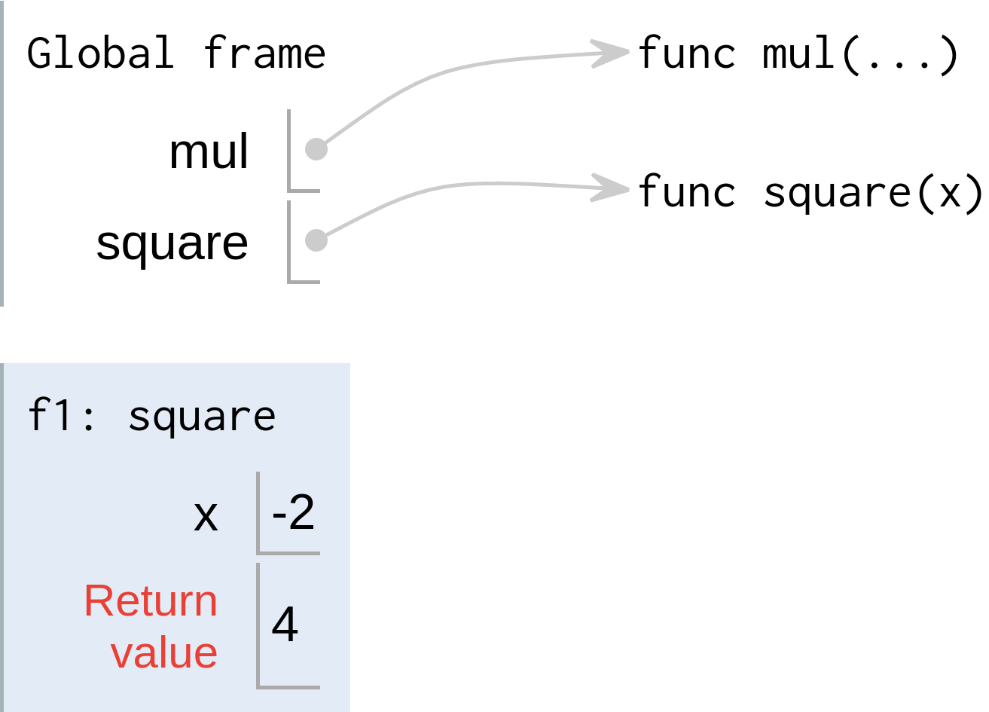
Calling User-Defined Functions
Procedure for calling/applying user-defined functions (for now)
Create a new environment frame
Bind the function's parameters to its arguments in that frame
Execute the body of the function in the new environment
def square(x):
return x * x
square(-2)
Intrinsic name
Local frame

Slide 18
Calling User-Defined Functions
Procedure for calling/applying user-defined functions (for now)
Create a new environment frame
Bind the function's parameters to its arguments in that frame
Execute the body of the function in the new environment
def square(x):
return x * x
square(-2)
Parameter
Argument

Slide 19
Calling User-Defined Functions
Procedure for calling/applying user-defined functions (for now)
Create a new environment frame
Bind the function's parameters to its arguments in that frame
Execute the body of the function in the new environment
def square(x):
return x * x
square(-2)

Slide 20
Putting it all together
def square(x): return x * x
Evaluate
Evaluate the operator subexpression
Evaluate each operand subexpression
Apply
Apply the value of the operator subexpression to the values of the operand subexpression
Operator: square
Function: func square(x)
square(1 - 3)
Operand: 1-3
Argument: -2
Local frame
Formal parameter bound to argument

Slide 21
Names & Environments
Demo
Every expression is evaluated in the context of an environment.
An environment is a sequence of frames
So far, there have been two possible environments:
The global frame
A function's local frame, then the global frame
Rules for looking up names in user-defined functions (version 1)
Look it up in the local frame
If name isn't in local frame, look it up in the global frame
If name isn't in either frame, NameError
For Thursday
Notes:
For Thusday
http://pythontutor.com/visualize.html#code=def%20square%28x%29%3A%0A%20%20%20%20return%20x%20*%20x%0A%0Adef%20sum_of_squares%28x,%20y%29%3A%0A%20%20%20%20return%20square%28x%29%20%2B%20square%28y%29%0A%20%20%20%20%0Asum_of_squares%283,%204%29&cumulative=true&curInstr=0&heapPrimitives=nevernest&mode=display&origin=opt-frontend.js&py=3&rawInputLstJSON=%5B%5D&textReferences=false

Slide 22
Drawing Environment Diagrams
Option 1: Python Tutor (tutor.cs61a.org)
Useful for quick visualization or for environment diagram questions
Option 2: PythonAnywhere (editor.pythonanywhere.com)
Includes an integrated editor/interpreter
Good for more complicated code or if you want to debug
Developed by Rahul Arya, one of your tutors this summer!

Slide 23
Summary
Programs consist of statements, or instructions for the computer, containing expressions, which describe computation and evaluate to values.
Values can be assigned to names to avoid repeating computations.
An assignment statement assigns the value of an expression to a name in the current environment.
Functions encapsulate a series of statements that maps arguments to a return value.
A def statement creates a function object with certain parameters and a body and binds it to a name in the current environment.
A call expression applies the value of its operator, a function, to the value(s) or its operand(s), some arguments.

